Slide 1
Type script

Slide 2
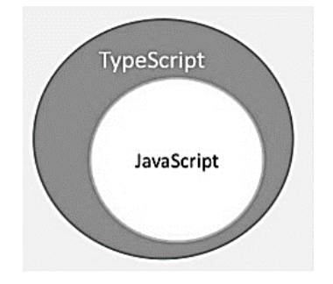
What is Typescript.
By definition, “TypeScript is JavaScript for application-scale development.”
TypeScript is a strongly typed, object oriented, compiled language. It was designed by Anders Hejlsberg (designer of C#) at Microsoft. TypeScript is both a language and a set of tools. TypeScript is a typed superset of JavaScript compiled to JavaScript. In other words, TypeScript is JavaScript plus some additional features.

Slide 3
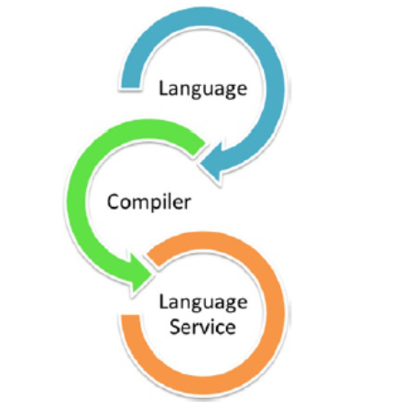
Components of Typescript.
Components of TypeScript
At its heart, TypeScript has the following three components −
Language − It comprises of the syntax, keywords, and type annotations.
The TypeScript Compiler − The TypeScript compiler (tsc) converts the instructions written in TypeScript to its JavaScript equivalent.
The TypeScript Language Service − The "Language Service" exposes an additional layer around the core compiler pipeline that are editor-like applications. The language service supports the common set of a typical editor operations like statement completions, signature help, code formatting and outlining, colorization, etc.

Slide 4
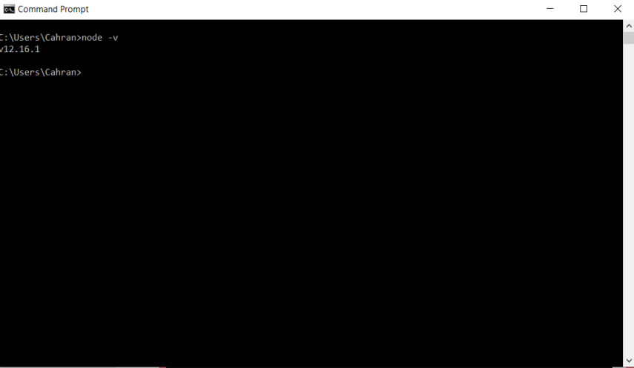
Installing Node js
You can download Node from the below given site:
https://nodejs.org/en/download/
After the installation type node –v to verify the installation is successful and node –v will give the version of node.

Slide 5
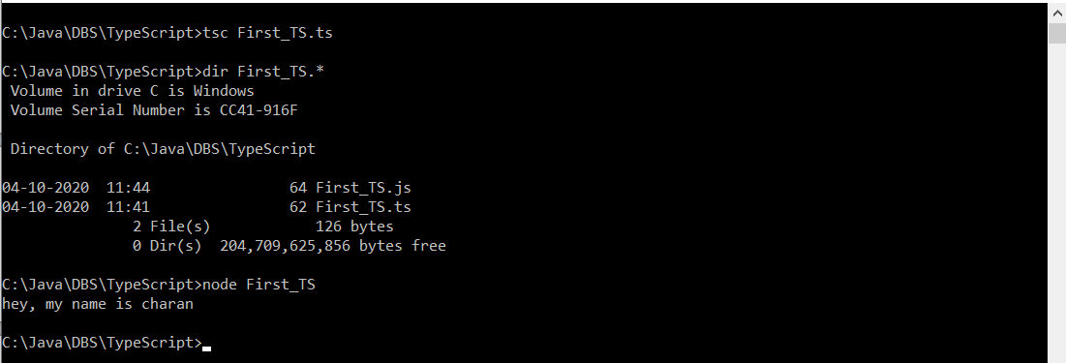
My First Type script.
Type the code.
var message= "hey, my name is charan";
console.log (message); → save in a file First_TS.ts.
On the console type tsc First_TS.ts
Check that js file is generated for it.
Execute the js file with node as node First_TS

Slide 6
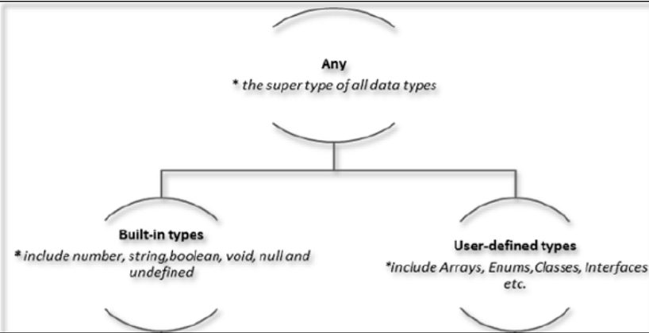
Type script types.
The Any type
The any data type is the super type of all types in TypeScript. It denotes a dynamic type. Using the any type is equivalent to opting out of type checking for a variable.
Built in data types : Number, Boolean, String
User-defined Types
User-defined types include Enumerations (enums), classes, interfaces, arrays, and tuple.

Slide 7
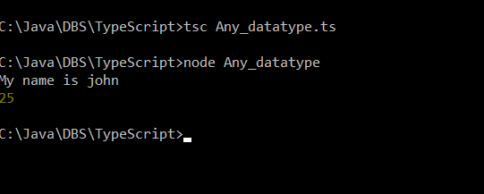
Any data type.
Here any datatype is used and this variable can hold any type of data.
var name1:any = "My name is john";
var age:any = 25;
console.log (name1);
console.log (age);

Slide 8
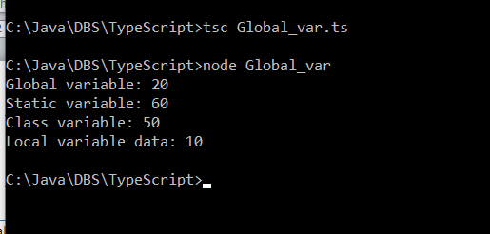
Global and local variables.
//Global variable and local variable.
var global_Var: number = 20;
class MyClass
{
local_var : number = 50;
static static_var : number = 60;
local_data():number
{
var local_val : number = 10;
return local_val;
}
}
console.log ("Global variable: "+global_Var);
console.log ("Static variable: "+MyClass.static_var);
var myClassObj = new MyClass();
console.log ("Class variable: "+ myClassObj.local_var);
console.log ("Local variable data: "+myClassObj.local_data());
Here the variables are declared as local and global variables and printed.

Slide 9
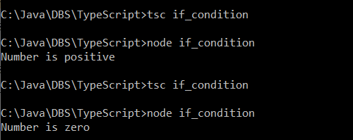
If condition.
var num = 0;
if (num > 0)
console.log ("Number is positive");
else if (num == 0)
console.log ("Number is zero");
else
console.log ("Number is negative");

Slide 10
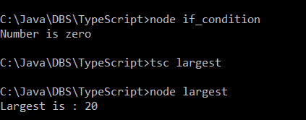
Functions
function largest (n1:number, n2:number) : number
{
if (n1 > n2)
return n1;
else
return n2;
}
console.log ("Largest is : "+ largest(10,20));

Slide 11
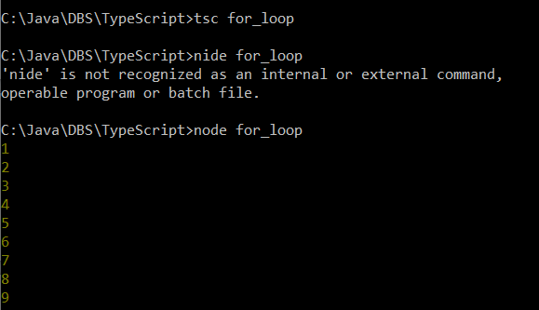
For loop
var num : number;
for (num=1; num < 10; ++num)
console.log (num);

Slide 12
Tuples.
At times, there might be a need to store a collection of values of varied types. Arrays will not serve this purpose. TypeScript gives us a data type called tuple that helps to achieve such a purpose.
It represents a heterogeneous collection of values. In other words, tuples enable storing multiple fields of different types.

Slide 13
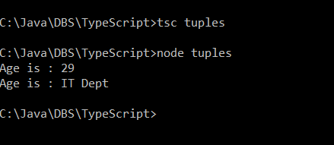
Tuples
var myData = [29, "IT Dept"];
console.log ("Age is : "+ myData[0]);
console.log ("Age is : "+ myData[1]);
Heterogenious data is stored in an array which is called as tuple. Here a tuple is created as array and its data is dispayed.

Slide 14
Union
TypeScript 1.4 gives programs the ability to combine one or two types. Union types are a powerful way to express a value that can be one of the several types. Two or more data types are combined using the pipe symbol (|) to denote a Union Type. In other words, a union type is written as a sequence of types separated by vertical bars.

Slide 15
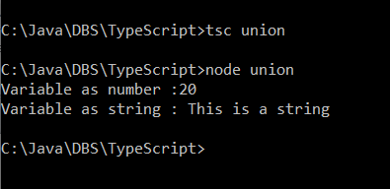
Union
var data:number|string;
data = 20;
console.log ("Variable as number :" +data);
data = "This is a string";
console.log ("Variable as string : "+data);

Slide 16
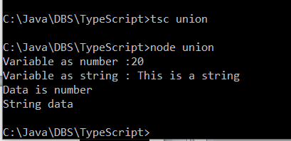
Typeof to determine data type.
var data:number|string;
data = 20;
console.log ("Variable as number :" +data);
data = "This is a string";
console.log ("Variable as string : "+data);
function dataType(data: number|string): void
{
if (typeof data == "string")
console.log ("String data");
else if (typeof data == "number")
console.log ("Data is number");
}
dataType (10);
dataType("This is string");

Slide 17
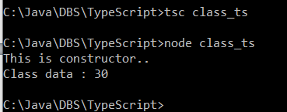
Classes in typescript.
//Class with constructor.
class myClass
{
myData : number=30 ;
constructor() { console.log ("This is constructor..");}
returnData() : number
{ return this.myData;}
}
var myClassObj = new myClass;
console.log ("Class data : " + myClassObj.returnData());

Slide 18

Class with constructor with arguments.
As of now overloaded constructors are not supported in typescript.
//Class with constructor.
class myClass
{
myData : number=30 ;
//constructor() { console.log ("This is constructor..");}
constructor(data : number) {this.myData = data;}
returnData() : number
{ return this.myData;}
}
//var myClassObj = new myClass;
//console.log ("Class data : " + myClassObj.returnData());
var myClassObj1 = new myClass (20);
console.log ("Class data : " + myClassObj1.returnData());

Slide 19
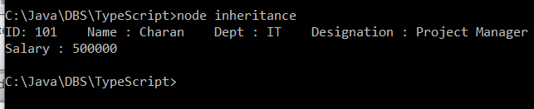
Class inheritance.
//This class demonstrates the inheritance and method overriding.
class Employee
{
id: number;
name: string;
dept:string;
designation : string;
display(): void
{
console.log ("ID: " + this.id + " Name : "+this.name + " Dept : "+ this.dept + " Designation : "+this.designation);
} }
class regular_employee extends Employee
{
salary : number;
constructor (id:number, name : string, dept: string, designation : string, salary: number)
{
super();
this.id = id;
this.name = name;
this.dept = dept;
this.designation = designation;
this.salary = salary;
}
display(): void
{
super.display();
console.log ("Salary : " + this.salary);
}
}
var regular_employeeObj = new regular_employee(101, "Charan", "IT" , "Project Manager", 500000);
regular_employeeObj.display();

Slide 20
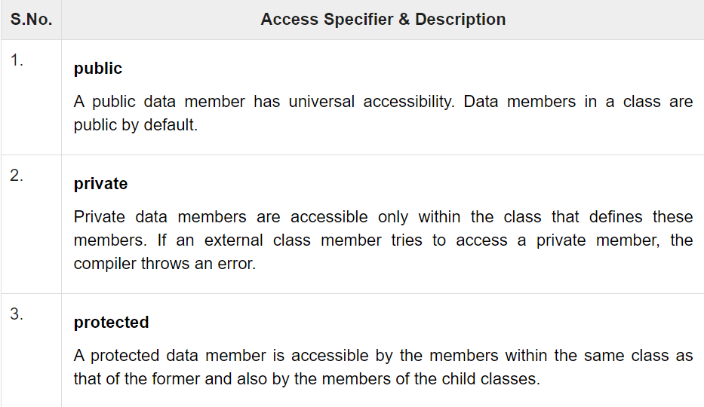
Class – Access specifier.

Slide 21
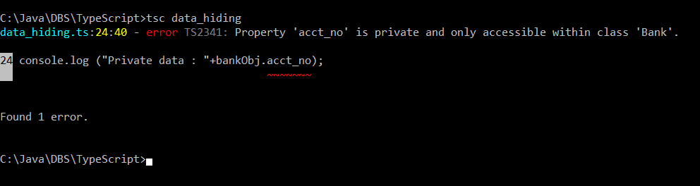
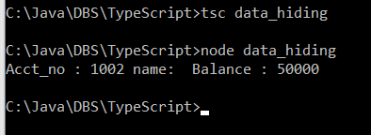
Class – Data hiding.
class Bank
{
private acct_no:number;
private name:string;
private balance : number;
constructor(acct_no:number, name:string, balance:number)
{
this.acct_no= acct_no;
this.name = name;
this.balance= balance;
}
display():void
{
console.log ("Acct_no : " + this.acct_no + " name: "+ " Balance : " + this.balance);
}
}
var bankObj = new Bank(1002, "Charan", 50000);
bankObj.display();
console.log ("Private data : "+bankObj.acct_no);
After commenting the last line of the code.

Slide 22

Interface.
interface IBank
{
assign_data(acct_no:number, name:string, balance:number) : void;
display():void;
}
class Bank implements IBank{
private acct_no:number;
private name:string;
private balance : number;
assign_data(acct_no:number, name:string, balance:number) : void
{
this.acct_no= acct_no;
this.name = name;
this.balance= balance;
}
display():void
{console.log ("Acct_no : " + this.acct_no + " name: "+ this.name + " Balance : " + this.balance);}
}
var bankObj = new Bank();
bankObj.assign_data(101, "Chiranjeevi", 50000);
bankObj.display();

Slide 23
Install angular.
Type the following commands to install angular.
Npm install –g @angular/cli
Ng new FirstApp
select routing and select css. It will generate the desired code.
Cd FirstApp
Ng serve → This starts the angular server.
Go to browser and type http://localhost:4200.

Slide 24
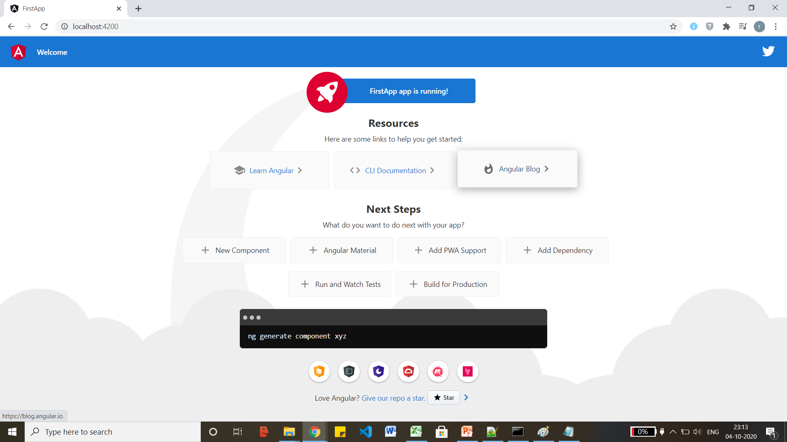
Angular firstapp.

